Slide 1

Loan Eligibility Predictor
A Machine Learning Approach to Bank Loan Approval Prediction
Project-3 By Nripen Kumar

Slide 2

Introduction
Problem Statement
Banks need an efficient way to assess loan applications to minimize risk and ensure fair lending.
Objective
Build a classification model that predicts whether a loan applicant should be approved or rejected based on:
Demographics (Gender, Marital Status, Dependents)
Financials (Income, Loan Amount, Credit History)
Education & Employment (Graduate, Self-Employed)
Property Area (Urban, Rural, Semiurban)
Expected Outcome
A user-friendly web application that helps banks automate loan approval decisions.

Slide 3

Approach
Data Analysis & Preprocessing
📌 Dataset Used:
Training Dataset (614 records)
Test Dataset (367 records)
📌 Key Steps:
1. Handled Missing Values
Numerical: Filled with median
Categorical: Filled with most frequent value
2. Feature Encoding
Categorical → One-Hot Encoding (Gender, Married, Education, etc.)
Target (Loan_Status) → Label Encoding (Y=1, N=0)
Model Selection & Training
✅ Algorithms Used:
Logistic Regression (Baseline)
Random Forest (Ensemble method for better accuracy)
✅ Evaluation Metrics:
Accuracy
ROC-AUC Score
Confusion Matrix

Slide 4
Execution
Step 1: Data Loading & Cleaning
Step 2: Feature Engineering
# Load data
train_df = pd.read_csv("Training Dataset.csv")
test_df = pd.read_csv("Test Dataset.csv")
# Handle missing values
num_imputer = SimpleImputer(strategy='median')
cat_imputer = SimpleImputer(strategy='most_frequent')
# One-Hot Encoding for categorical features
preprocessor = ColumnTransformer(
transformers=[
('num', num_imputer, numerical_cols),
('cat', cat_imputer, categorical_cols)
])

Slide 5
Step 3: Model Training
Step 4: Model Evaluation
Performance Metrics:
# Train Random Forest & Logistic Regression
models = {
'Random Forest': RandomForestClassifier(),
'Logistic Regression': LogisticRegression()
}
best_model = None
best_score = 0
for name, model in models.items():
model.fit(X_train, y_train)
score = accuracy_score(y_test, model.predict(X_test))
if score > best_score:
best_score = score
best_model = model
Model | Accuracy | ROC-AUC
Logistic Regression | 78% | 0.82
Random Forest | 83% | 0.87
Visualizations:
ROC Curve (AUC = 0.87)
Confusion Matrix (Precision & Recall)

Slide 6

Deployment
Web Application (Flask)
🌐 Features: ✔ Single Prediction (Form-based input) ✔ Batch Prediction (CSV upload) ✔ Interactive Results (Approved/Rejected with confidence %)
📱 Tech Stack:
Frontend: HTML, CSS, Bootstrap
Backend: Flask (Python)
ML Model: Scikit-learn
🔗 How to Run?
pip install -r requirements.txt
python app.py

Slide 7

Results & Insights
Key Findings
✅ Top Features Affecting Loan Approval:
Credit History (Most important)
Applicant Income
Loan Amount
Property Area
❌ Common Reasons for Rejection:
Low credit score (Credit_History = 0)
High loan amount relative to income
Non-graduate applicants
Business Impact
🚀 Benefits for Banks: ✔ Faster loan processing ✔ Reduced human bias ✔ Lower default risk

Slide 8
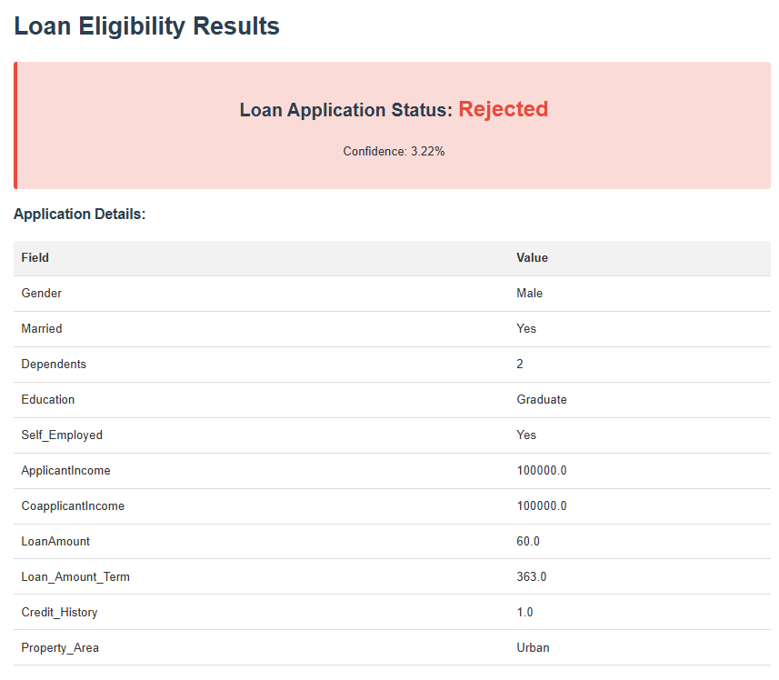
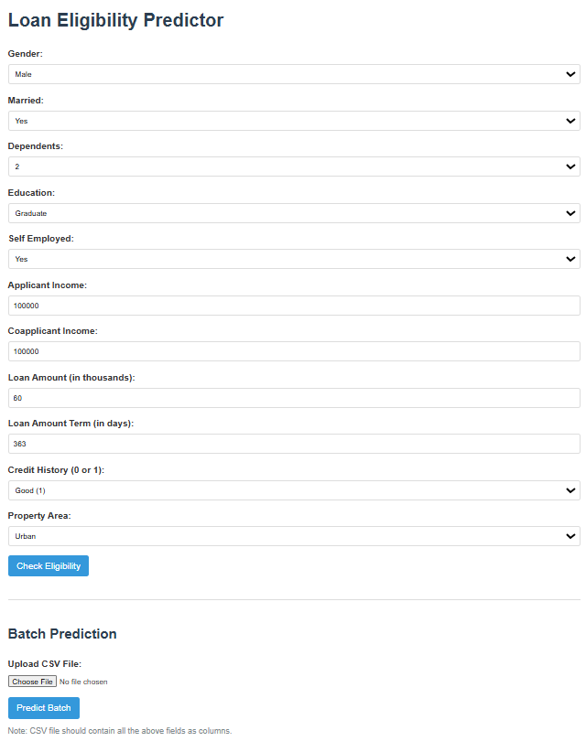
Insights and Outcomes

Slide 9
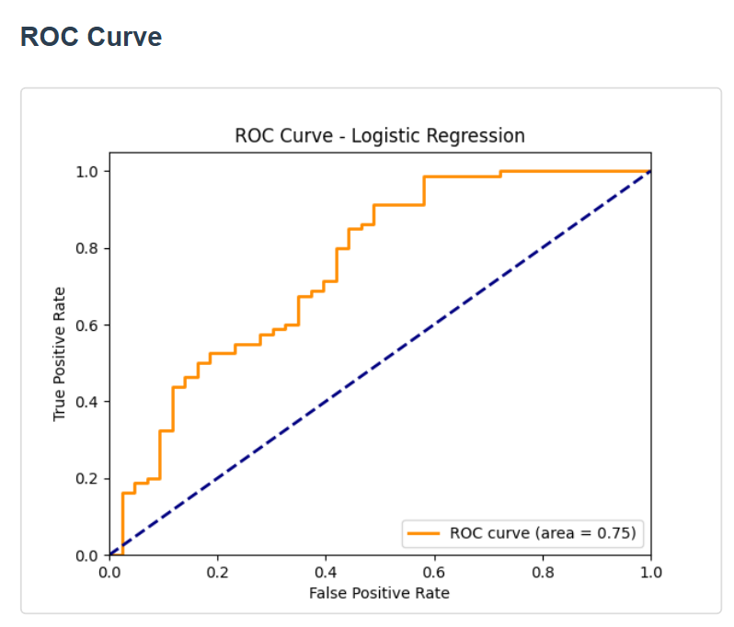
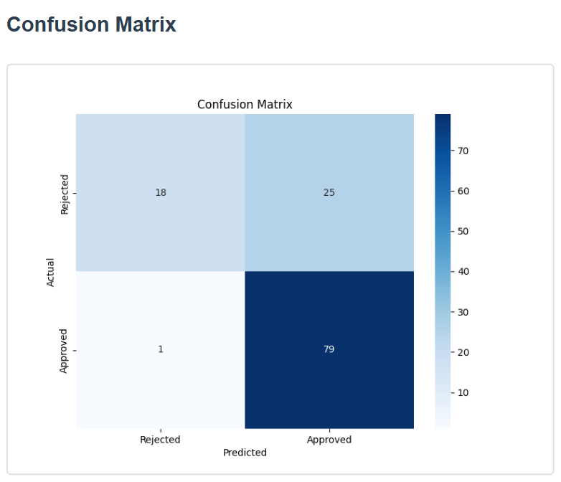
Demo Output and Insights

Slide 10
Future Improvements
Possible Enhancements:
More advanced models (XGBoost, Neural Networks)
Explainable AI (SHAP values for feature importance)
Mobile App Integration

Slide 11

Conclusions
📌 Successfully built a Loan Eligibility Predictor with 83% accuracy. 📌 Deployed as a web app for real-time predictions. 📌 Helps banks automate loan approvals efficiently.
🚀 Next Steps: Improve model with more data & advanced techniques.

Slide 12
Thank you!
Do you have any questions?

